Slide 1
Cryptographic Hash Functions
Dr. B C Dhara
Department of Information Technology
Jadavpur University

Slide 2
Objectives
Introduce general ideas behind cryptographic
hash functions
Discuss the Merkle-Damgard scheme as the basis
for iterated hash functions
Distinguish between two categories of hash
functions
Discuss the structure of SHA-512
Discuss the structure of Whirlpool
B C Dhara, Dept. of IT, JU

Slide 3
Introduction
A cryptographic hash function takes a message of arbitrary length and creates a message digest of fixed length
The ultimate goal of this chapter is to discuss the details of the two most promising cryptographic hash algorithms
  SHA-512 and
  Whirlpool.
B C Dhara, Dept. of IT, JU

Slide 4
Iterated Hash Function
Hash function creates fixed length digest out of a variable size message
  Instead of variable size input, a fixed size input is created and may be iterated a number of times
    Fixed size input function is referred as compression function
    Normally n-bit string is mapped to m-bit string where n > m
    This scheme is referred as iterated cryptographic hash function
B C Dhara, Dept. of IT, JU

Slide 5
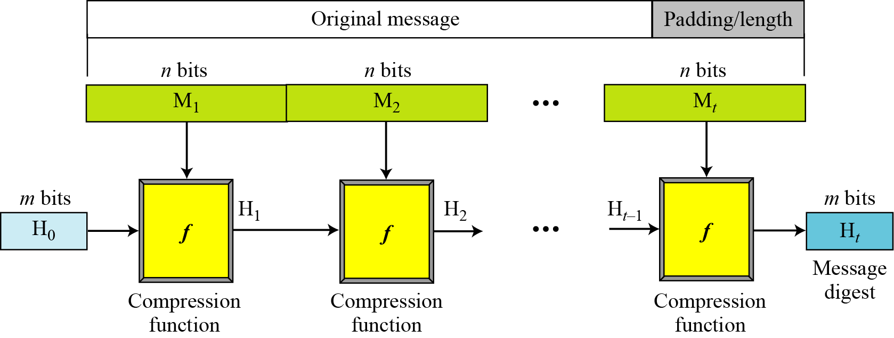
Merkle-Damgard Scheme
H₀ is the initial digest, also known as initial vector (IV)
H_{i} =f(H_{i-1}, M_{i}), f is the compression function
H_{t} = h(M)
If compression function is collision resistance, the hash function is also collision resistance
B C Dhara, Dept. of IT, JU

Slide 6
Two Groups of Compression Functions
The compression function is made from scratch
  Message Digest (MD), SHA
A symmetric-key block cipher serves as a compression function
  Whirlpool
B C Dhara, Dept. of IT, JU

Slide 7
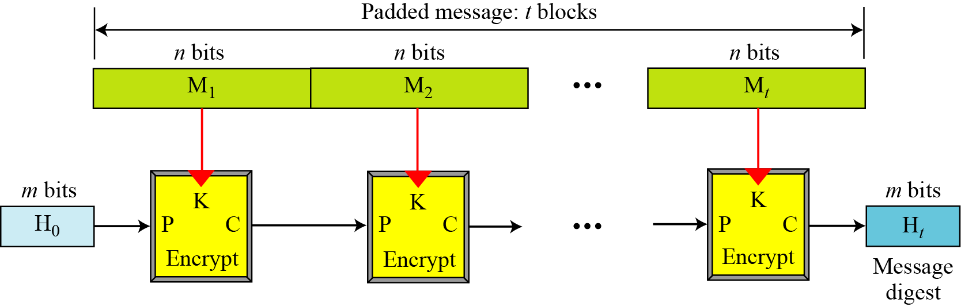
Hash function: Rabin Scheme
In this scheme, compression function is replaced by any encrypting cipher
Message block is used as key
Previously created digest is used as plaintext
Algorithm is simple, subject to meet-in-the-middle attack
B C Dhara, Dept. of IT, JU

Slide 8
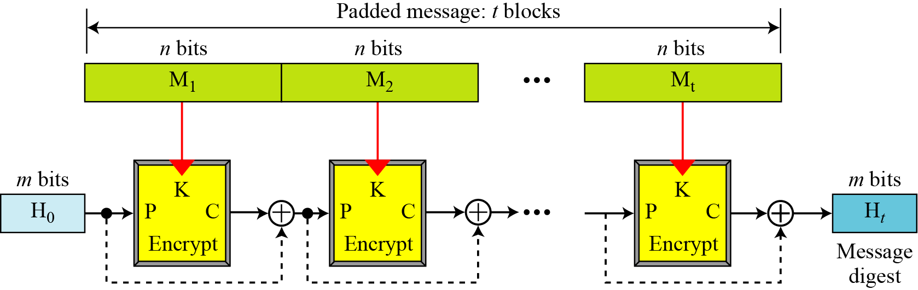
Hash function: Davies-Meyer Scheme
To protect against meet-in-middle-attack
Digest is used as feed-forward to protect …
B C Dhara, Dept. of IT, JU

Slide 9
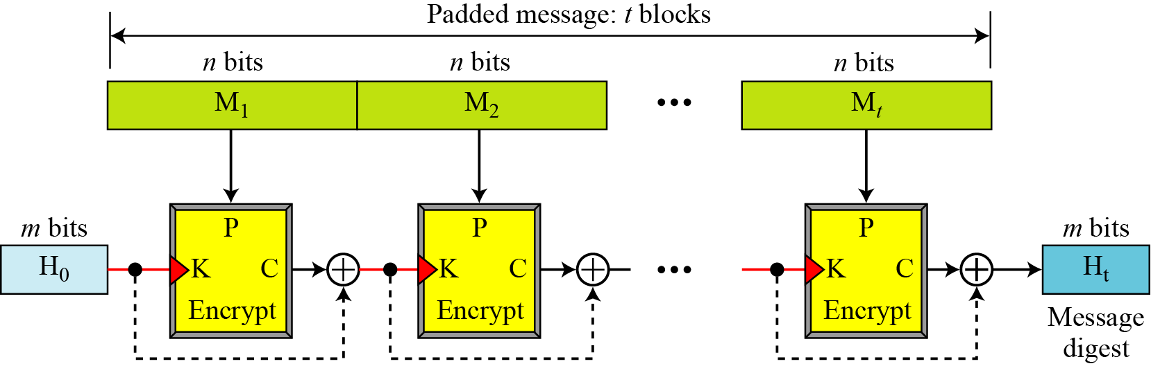
Hash function: Davies-Meyer-Oseas Scheme
Message is used as plaintext
Digest is used as key
B C Dhara, Dept. of IT, JU

Slide 10
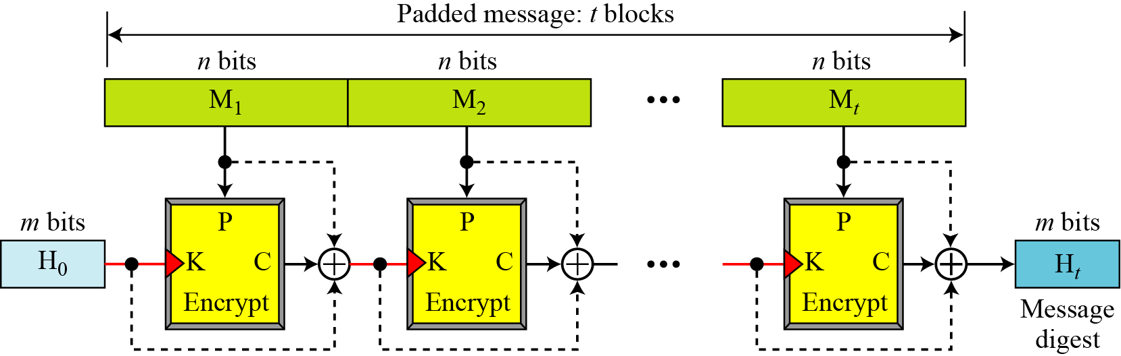
Hash function: Miyaguchi-Preneel Scheme
It is extended version of Davies-Meyer-Oseas Scheme
Plaintext, cipher key, ciphertext are all XOR-ed to create new digest
This scheme is used in whirlpool
B C Dhara, Dept. of IT, JU

Slide 11
MD hash family
MD4 is a very efficient hash function based on the principles by Merkle and Damgard
The compression function can be split into two parts:
  message expansion: input message block is expanded into a number of words
  Step operations: where expanded message is processed
B C Dhara, Dept. of IT, JU

Slide 12
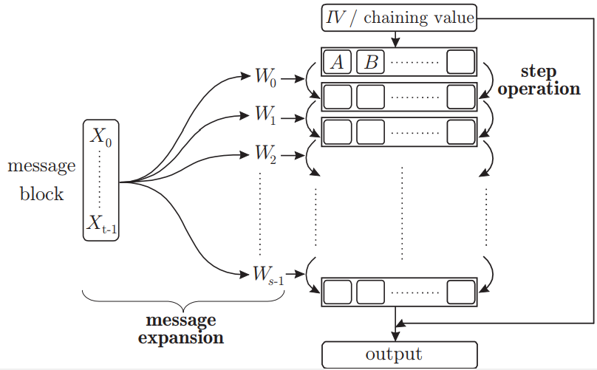
Basic structure is as follows:
B C Dhara, Dept. of IT, JU

Slide 13
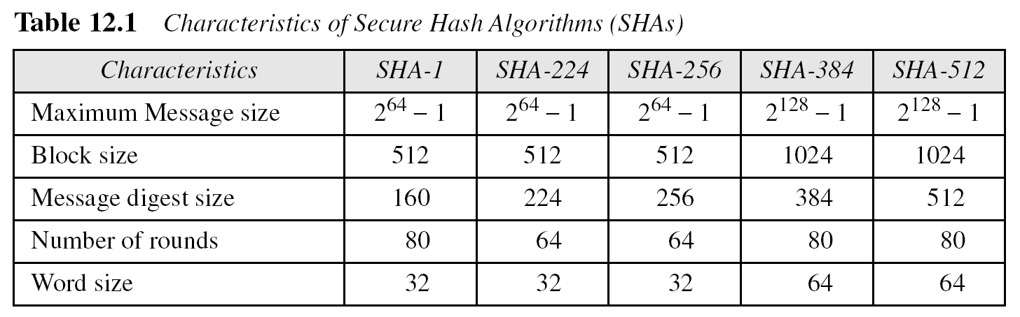
SHA-512
SHA-512 is the version of SHA with a 512-bit message digest
This version, like the others in the SHA family of algorithms, is based on the Merkle-Damgard scheme
B C Dhara, Dept. of IT, JU

Slide 14

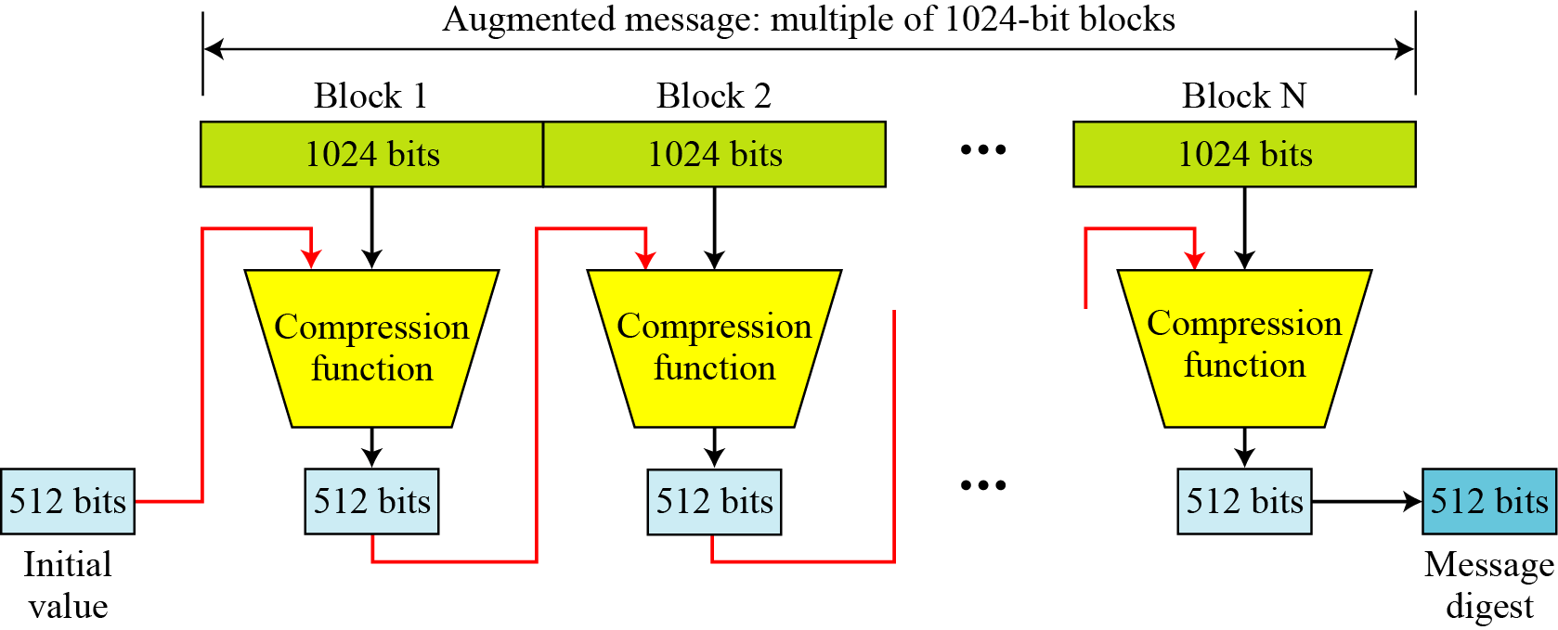
SHA-512 (contd…)
SHA-512 creates a 512-bit message digest out of a message less than 2¹²⁸.
B C Dhara, Dept. of IT, JU

Slide 15
Example: SHA-512
This example shows that the message length limitation of SHA-512 is not a serious problem. Suppose we need to send a message that is 2¹²⁸ bits in length. How long does it take for a communications network with a data rate of 2⁶⁴ bits per second to send this message?
Solution
A communications network that can send 2⁶⁴ bits per second is not yet available. Even if it were, it would take many years to send this message. This tells us that we do not need to worry about the SHA-512 message length restriction.
B C Dhara, Dept. of IT, JU

Slide 16
Example: SHA-512 (contd…)
This example also concerns the message length in SHA-512. How many pages are occupied by a message of 2¹²⁸ bits?
Solution
Suppose that a character is 32, or 2⁶, bits. Each page is less than 2048, or approximately 2¹², characters. So 2¹²⁸ bits need at least 2¹²⁸ / 2¹⁸, or 2¹¹⁰, pages. This again shows that we need not worry about the message length restriction.
B C Dhara, Dept. of IT, JU

Slide 17
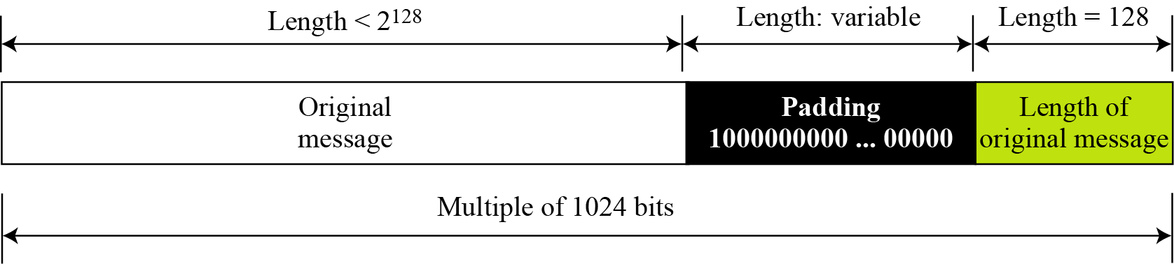
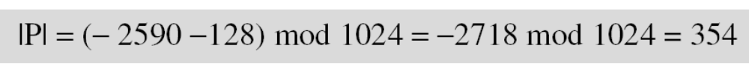
SHA-512: length field and padding
|M| + |P| + 128 ≡ 0 mod 1024 ➔ |P|= (-|M| -128) mod 1024
What is the number of padding bits if the length of the original message is 2590 bits?
The padding consists of one 1 followed by 353 0’s.
B C Dhara, Dept. of IT, JU

Slide 18
SHA-512: length field and padding (contd…)
Do we need padding if the length of the original message is already a multiple of 1024 bits?
Solution
Yes we do, because we need to add the length field. So padding is needed to make the new block a multiple of 1024 bits.
B C Dhara, Dept. of IT, JU

Slide 19
SHA-512: length field and padding (contd…)
What is the minimum and maximum number of padding bits that can be added to a message?
The minimum length of padding is 0 and it happens when
(−M − 128) mod 1024 is 0. This means that |M| = −128 mod 1024 = 896 mod 1024 bits. In other words, the last block in the original message is 896 bits.
The maximum length of padding is 1023 and it happens when (−|M| −128) = 1023 mod 1024. This means that the length of the original message is |M| = (−128 −1023) mod 1024 or the length is |M| = 897 mod 1024. In this case, we cannot just add the length field because the length of the last block exceeds one bit more than 1024. So we need to add 897 bits to complete this block and create a second block of 896 bits.
B C Dhara, Dept. of IT, JU

Slide 20
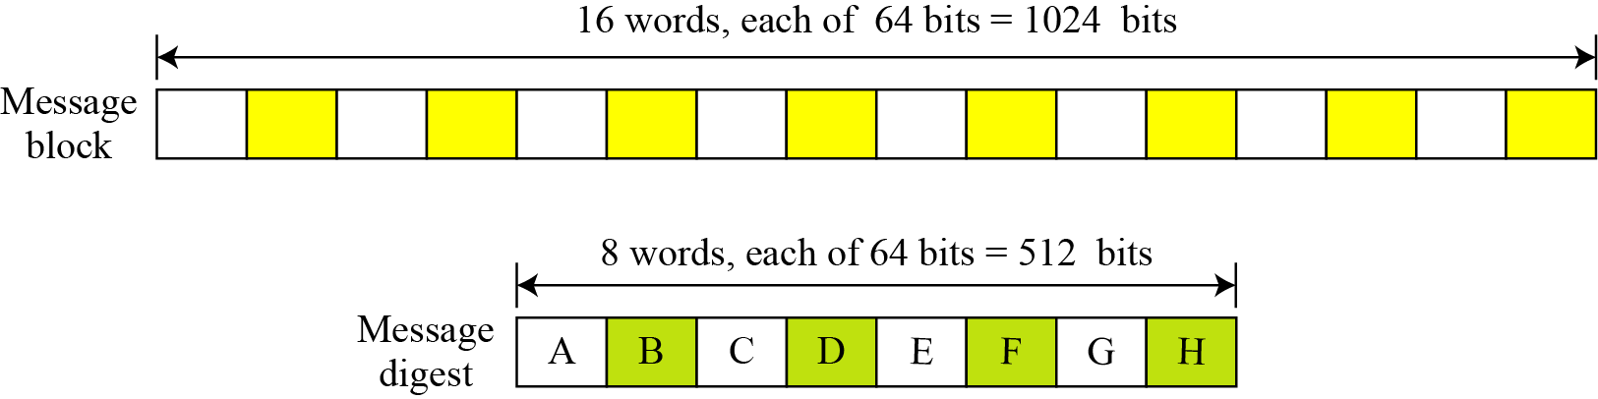
Words and word expansion
SHA-512 operates in word oriented
B C Dhara, Dept. of IT, JU

Slide 21
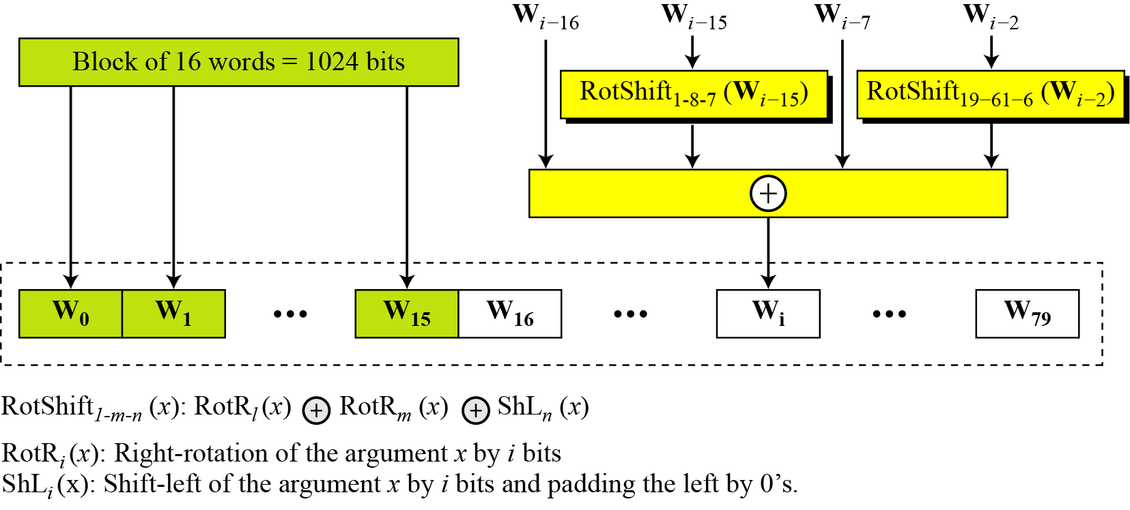
Words and word expansion (contd…)
We have 16 words; we will see that 80 words are needed in the processing ➔ word expansion
padding the right by 0’s
B C Dhara, Dept. of IT, JU

Slide 22
Example: word expansion
How w60 is made?
B C Dhara, Dept. of IT, JU

Slide 23
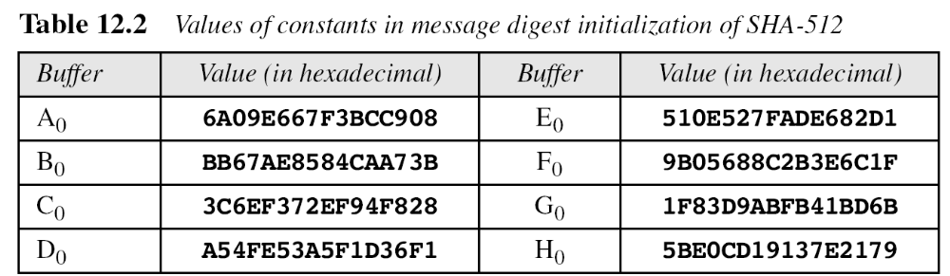
Message digest initialization
SHA-512 uses following IV
First 8 prime numbers: 2, 3, 5, 7, 11, 13, 17, 19
Sqrt(prime) and binary representation of fraction and consider 64 bits
B C Dhara, Dept. of IT, JU

Slide 24
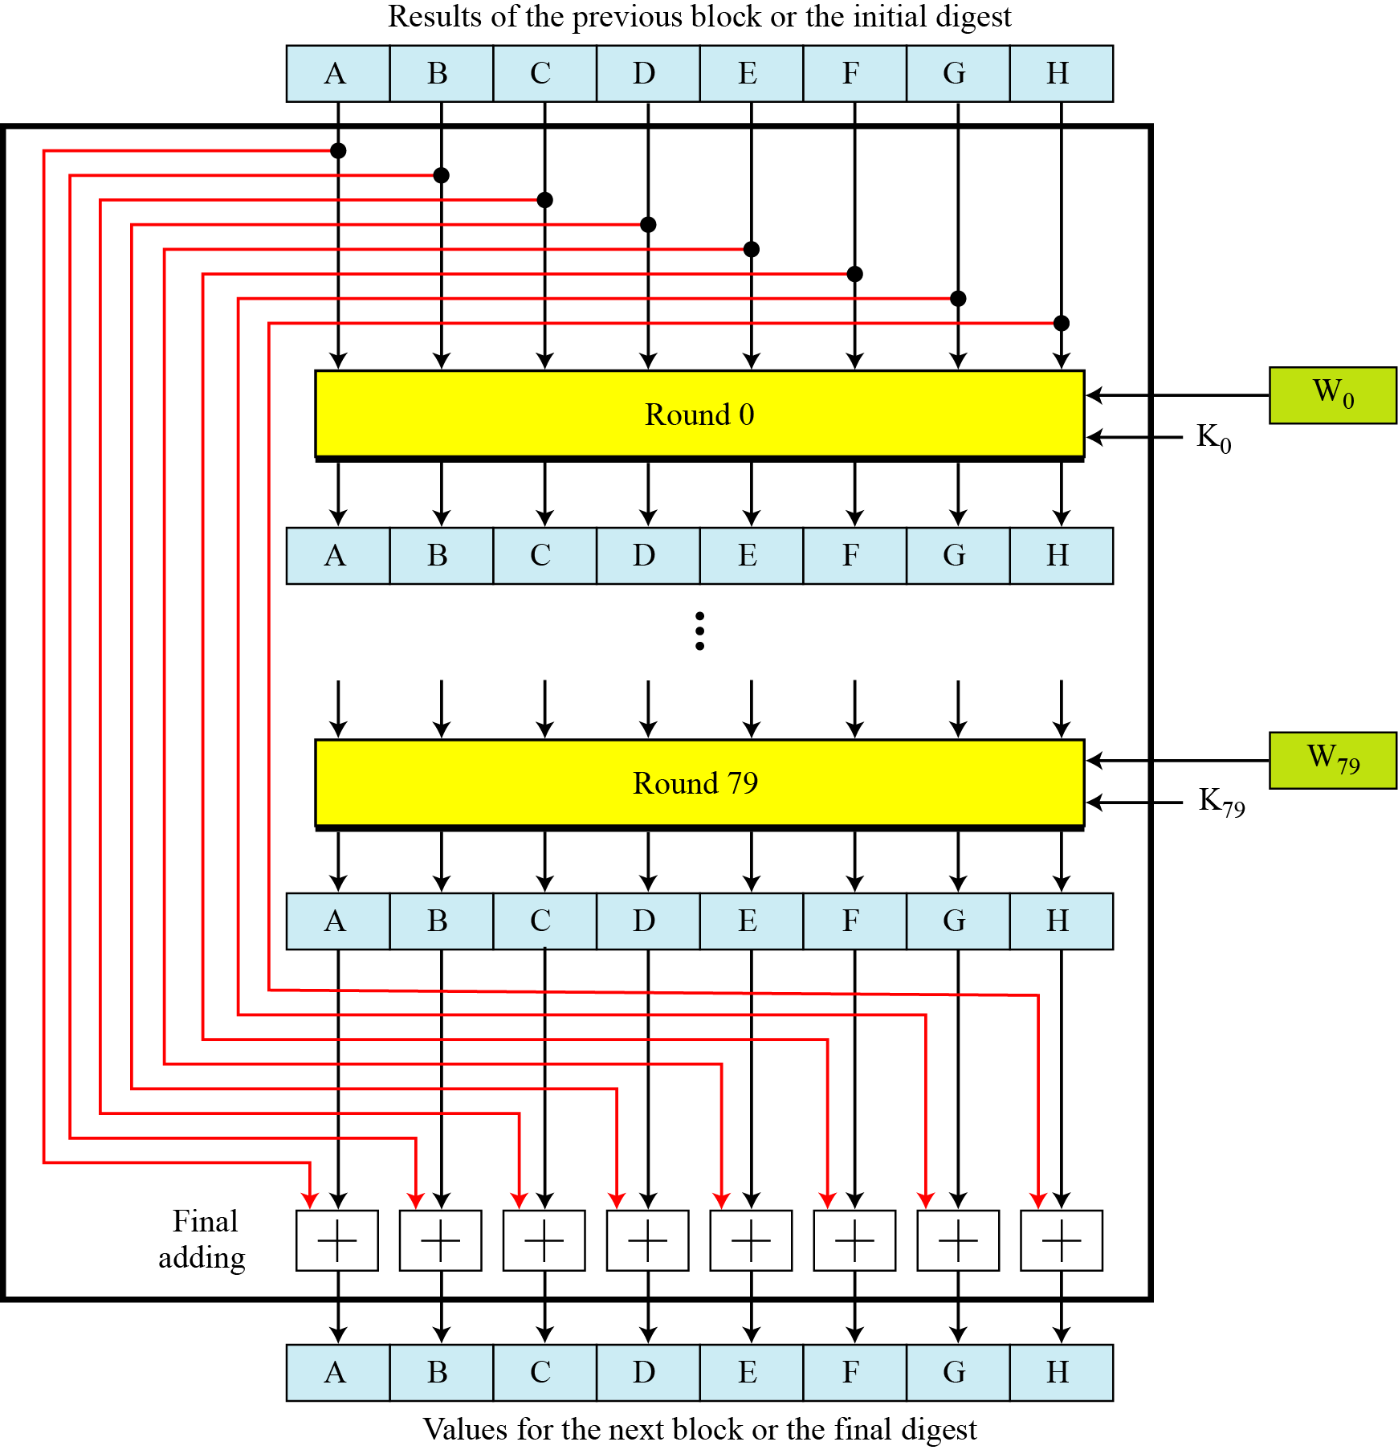
Compression function
Each block is processed in 80 rounds (one word in each round)
In each round:
Values in eight buffer (prev round/block-512 bits), word (64-bits) and key (64-bits) are mixed
Initial value of the registers are saved and added with result of 79-th round to achieve the value for next block/ final digest
SHA-512 creates a 512-bits digest from multiple 1024 blocks
B C Dhara, Dept. of IT, JU

Slide 25
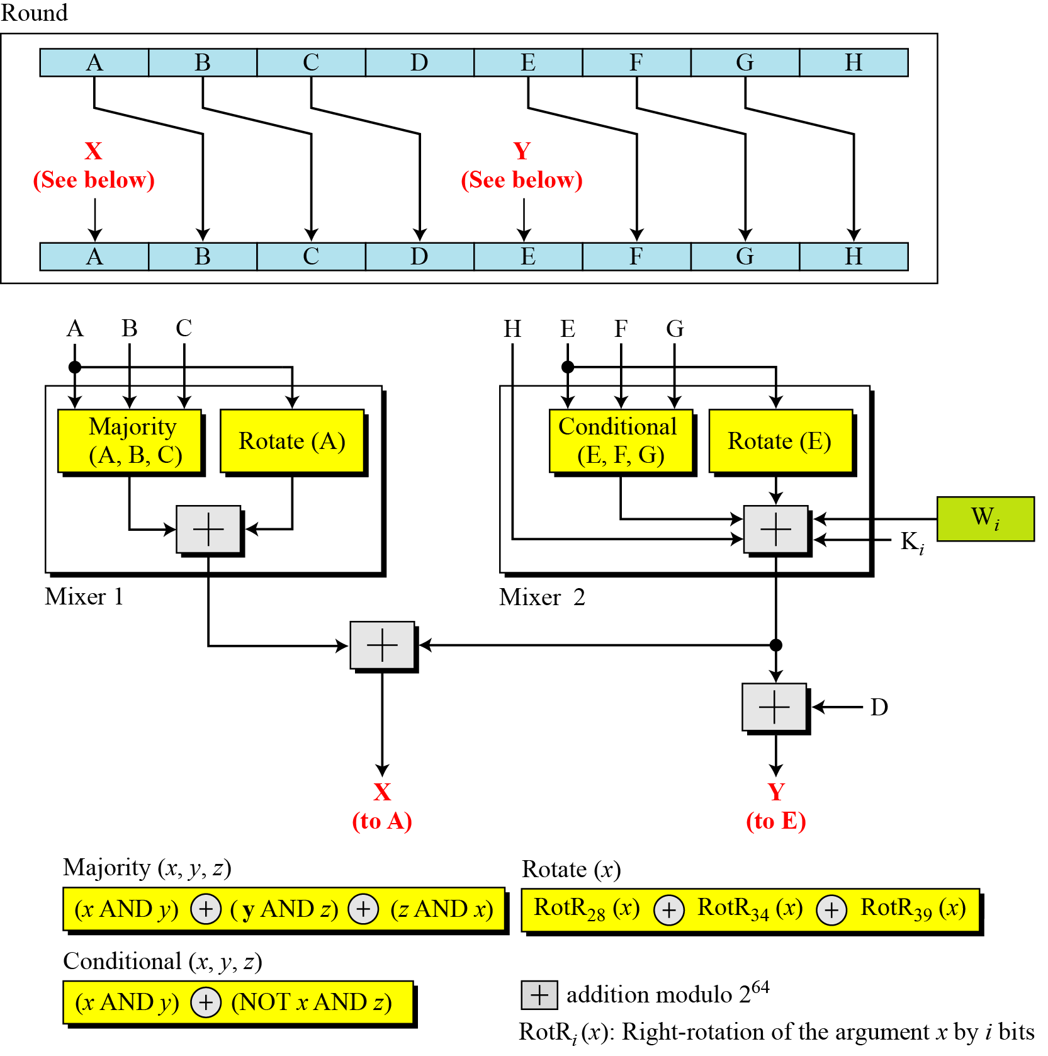
Structure of each round of SHA-512
Conditional:
If x then y else z
B C Dhara, Dept. of IT, JU

Slide 26
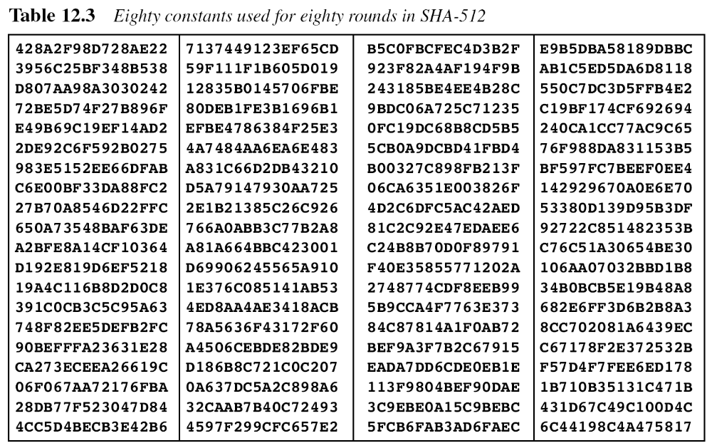
Round keys
First 80 prime numbers: 2, 3, 5, 7, 11, 13, 17, 19 …
Cube-root(prime) and binary representation of fraction and consider 64 bits
B C Dhara, Dept. of IT, JU

Slide 27
Round keys
For example, the 80th prime is 409, with the cubic root (409)^{1/3} = 7.42291412044. Converting this number to binary with only 64 bits in the fraction part, we get
The fraction part: (6C44198C4A475817)₁₆
B C Dhara, Dept. of IT, JU

Slide 28
Example: majority function
We apply the Majority function on buffers A, B, and C. If the leftmost hexadecimal digits of these buffers are 0x7, 0xA, and 0xE, respectively, what is the leftmost digit of the result?
Solution
The digits in binary are 0111, 1010, and 1110.
a. The first bits are 0, 1, and 1. The majority is 1.
b. The second bits are 1, 0, and 1. The majority is 1.
c. The third bits are 1, 1, and 1. The majority is 1.
d. The fourth bits are 1, 0, and 0. The majority is 0.
The result is 1110, or 0xE in hexadecimal.
B C Dhara, Dept. of IT, JU

Slide 29
Example: conditional function
We apply the Conditional function on E, F, and G buffers. If the leftmost hexadecimal digits of these buffers are 0x9, 0xA, and 0xF respectively, what is the leftmost digit of the result?
Solution
The digits in binary are 1001, 1010, and 1111.
a. The first bits are 1, 1, and 1. The result is F₁, which is 1.
b. The second bits are 0, 0, and 1. The result is G₂, which is 1.
c. The third bits are 0, 1, and 1. The result is G₃, which is 1.
d. The fourth bits are 1, 0, and 1. The result is F₄, which is 0.
The result is 1110, or 0xE in hexadecimal.
B C Dhara, Dept. of IT, JU

Slide 30
Analysis of SHA-512
With a message digest of 512 bits, SHA-512 expected to be resistant to all attacks, including collision attacks.
B C Dhara, Dept. of IT, JU

Slide 31
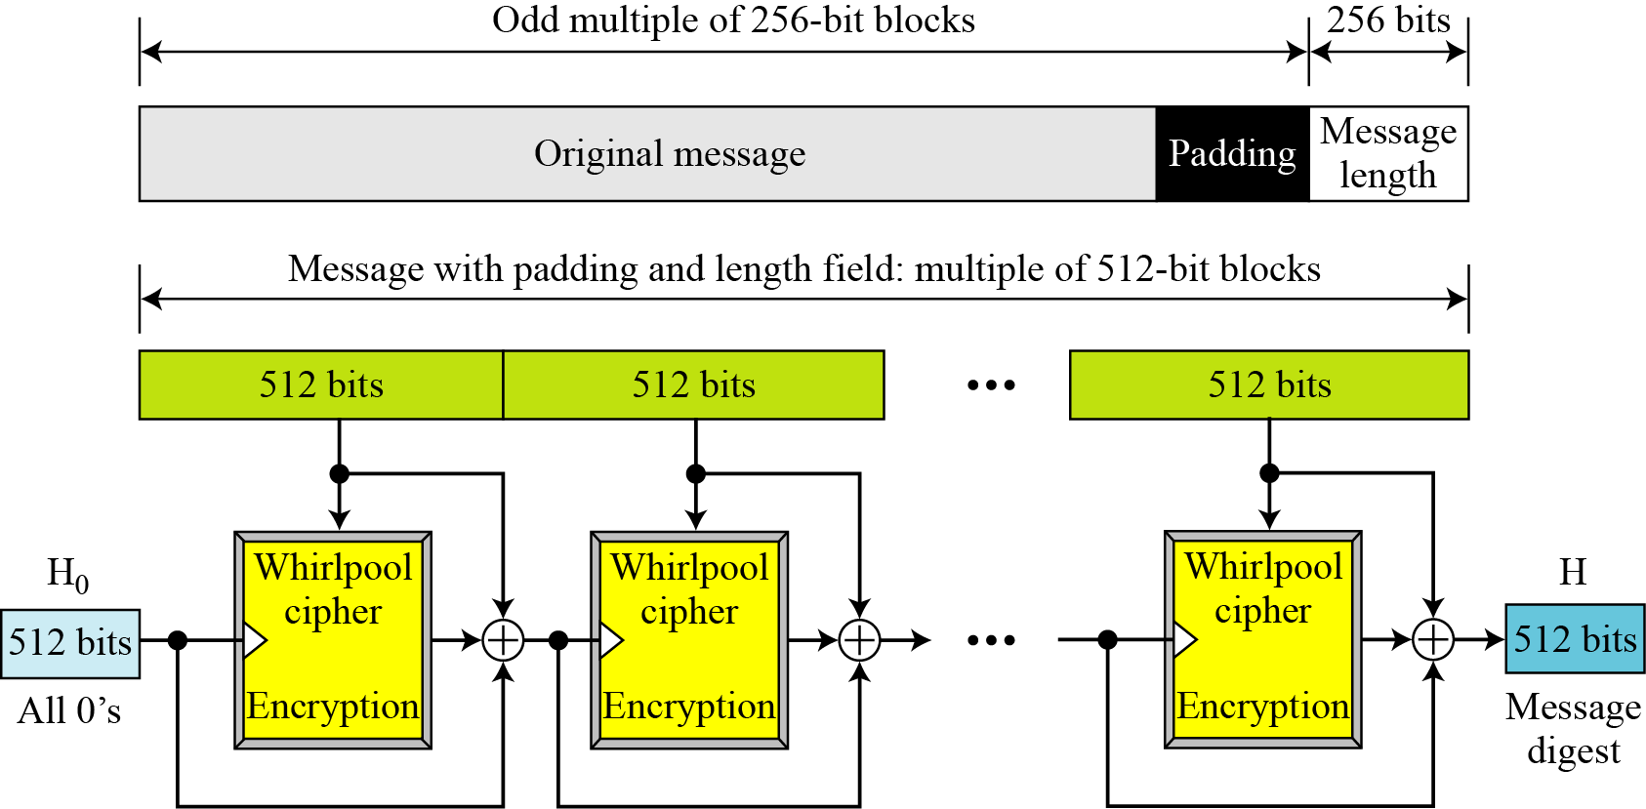
WHIRLPOOL
Whirlpool is an iterated cryptographic hash function, based on the Miyaguchi-Preneel scheme, that uses a symmetric-key block cipher in place of the compression function
Whirlpool cipher is like AES
B C Dhara, Dept. of IT, JU

Slide 32
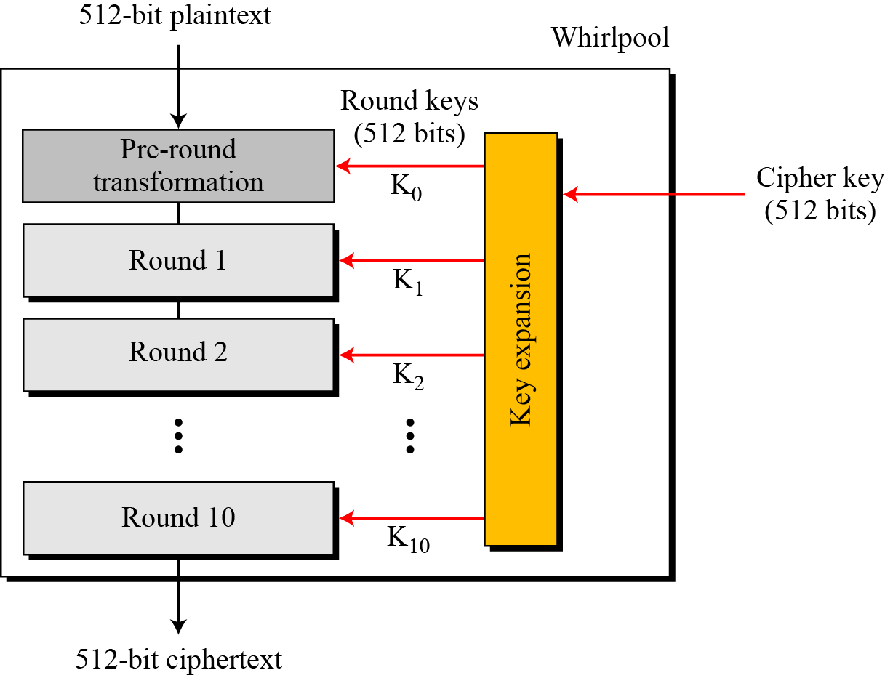
Rounds of Whirlpool cipher
B C Dhara, Dept. of IT, JU

Slide 33
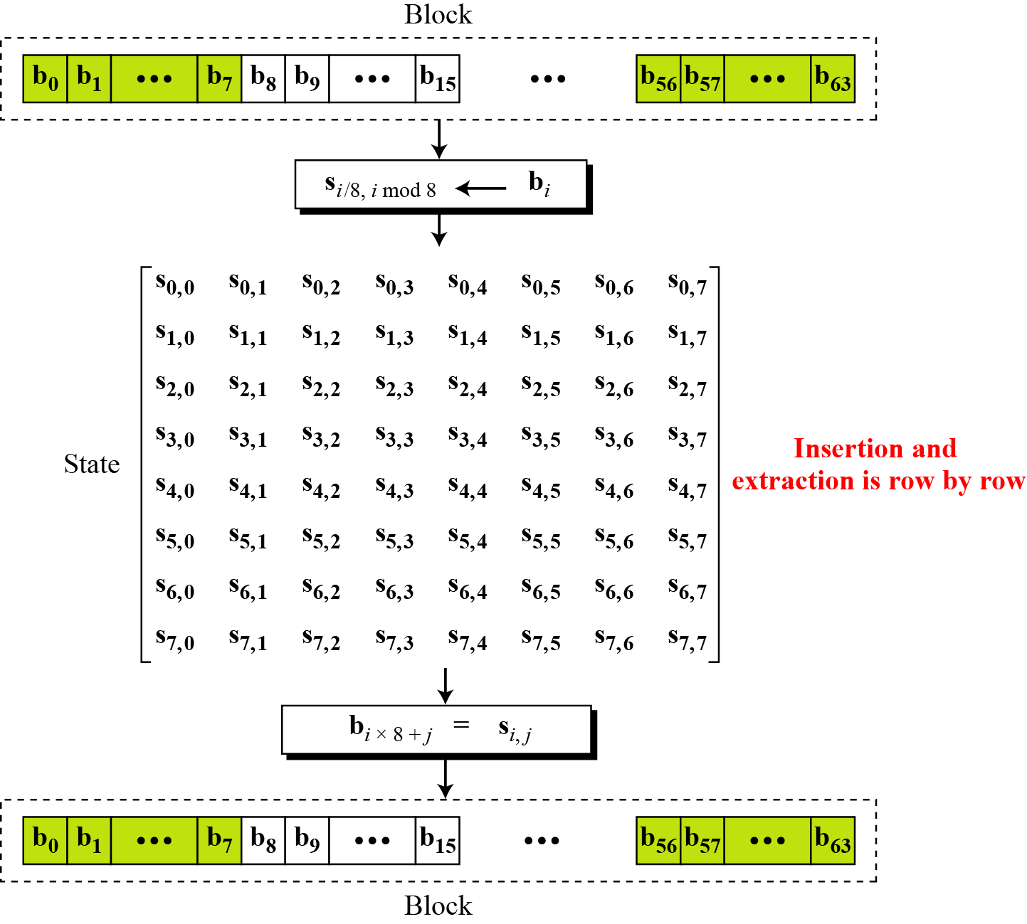
Block and state in the Whirlpool cipher
B C Dhara, Dept. of IT, JU

Slide 34
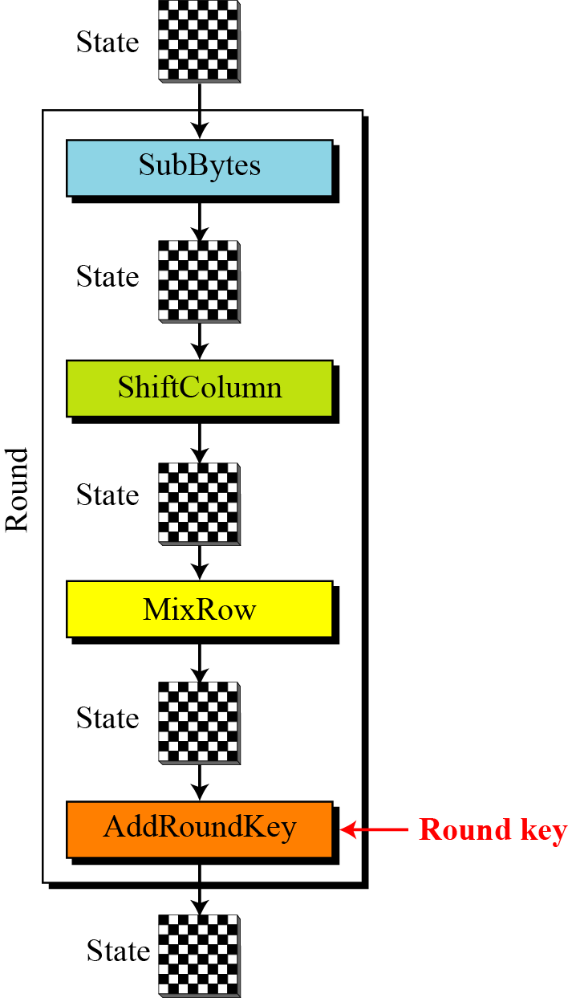
Structure of each round
B C Dhara, Dept. of IT, JU

Slide 35
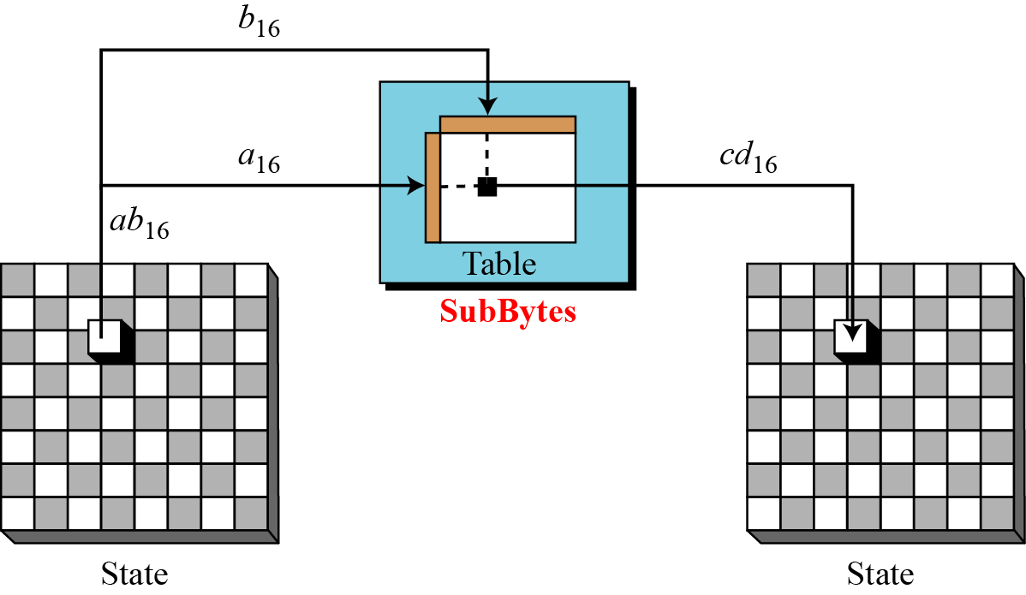
SubBytes transformations in the Whirlpool cipher
SubBytes Like in AES, SubBytes provide a nonlinear transformation.
B C Dhara, Dept. of IT, JU

Slide 36
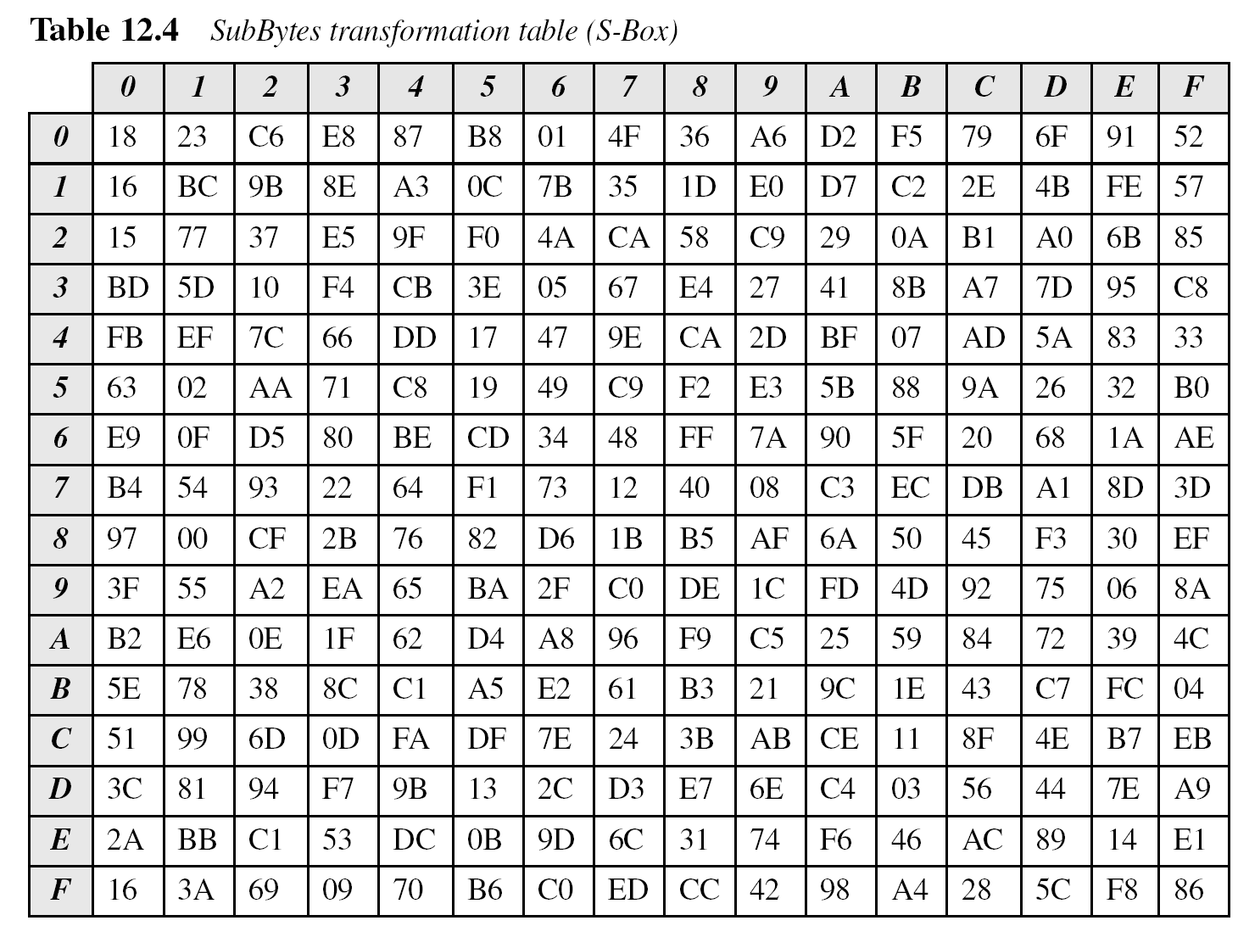
SubBytes transformation table
Algebrically this table can be computed in GF(2⁴) with the irreducible polynomial x⁴ + x+1
B C Dhara, Dept. of IT, JU

Slide 37
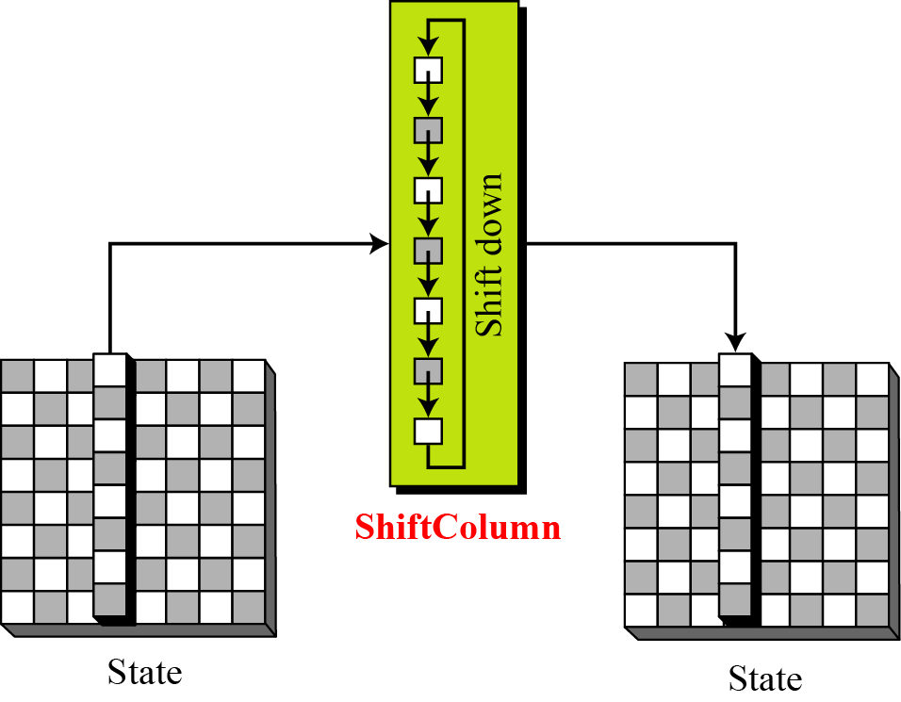
ShiftColumns transformation in the Whirlpool cipher
Column i shifted i amounts
B C Dhara, Dept. of IT, JU

Slide 38
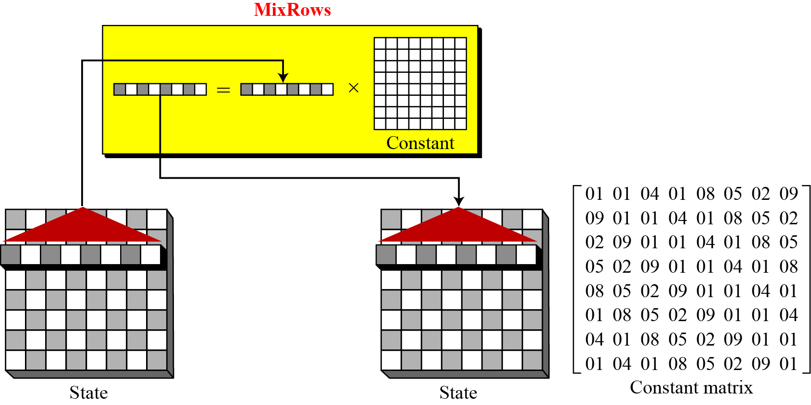
MixRows transformation in the Whirlpool cipher
B C Dhara, Dept. of IT, JU

Slide 39
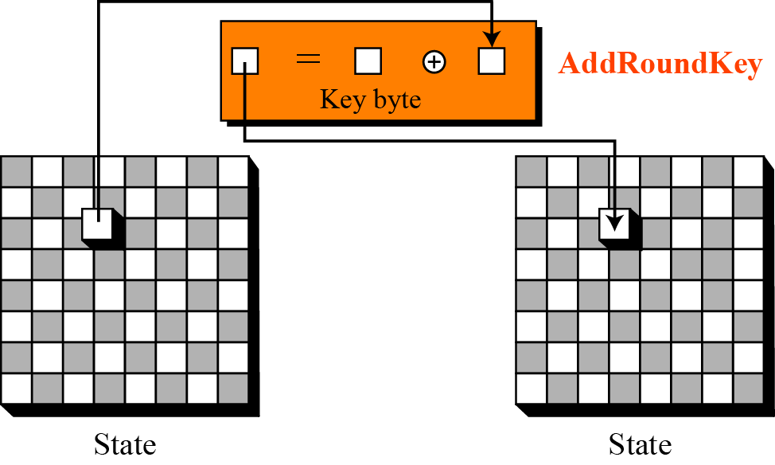
AddRoundKey transformation in the Whirlpool cipher
B C Dhara, Dept. of IT, JU

Slide 40
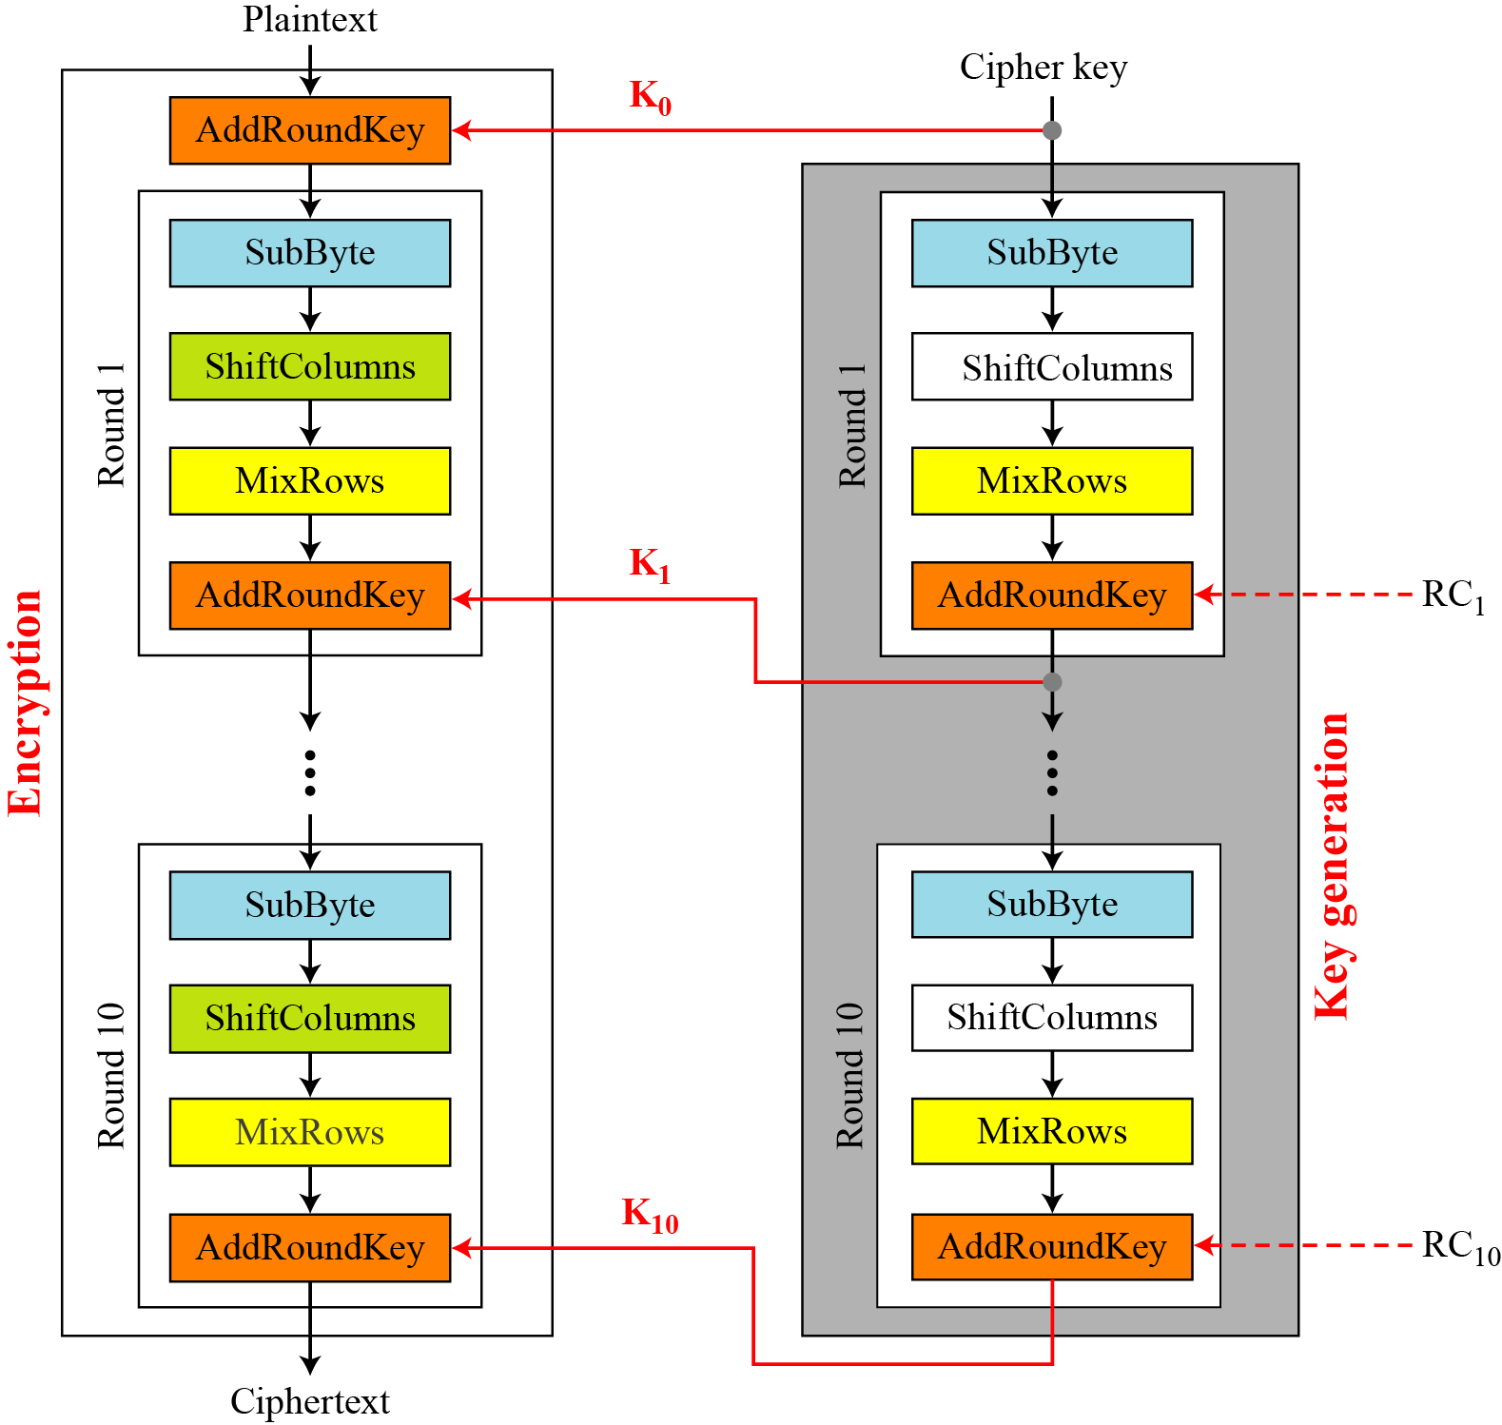
Key expansion in the Whirlpool cipher
B C Dhara, Dept. of IT, JU

Slide 41
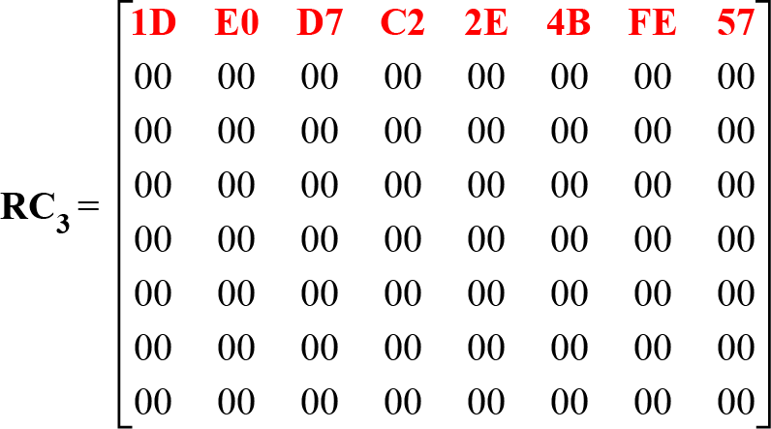
Round constant
Round constant is 8x8 matrix, a state, second – last row all are zero
RC_{round}(row, col)=SubByte(8*(rounrd-1)+col) if row =0
else RC_{round}(row, col)=0
B C Dhara, Dept. of IT, JU

Slide 42
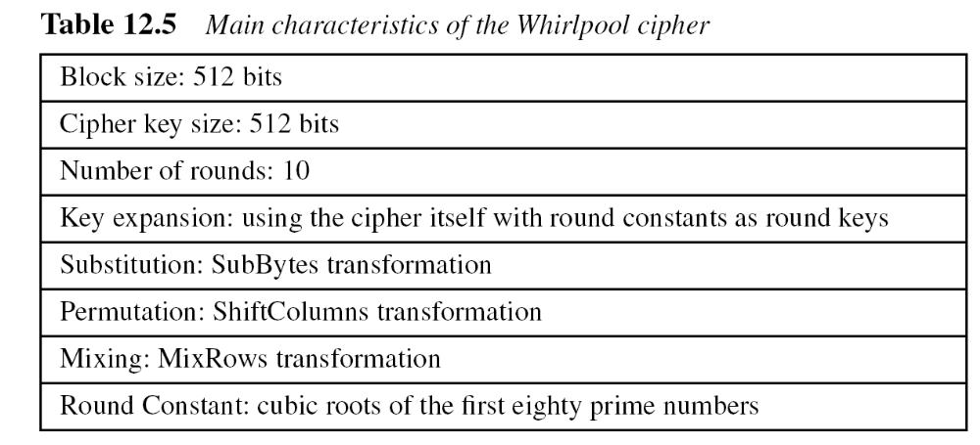
Characteristics of Whirlpool
B C Dhara, Dept. of IT, JU

